Slide 1
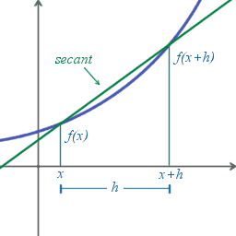
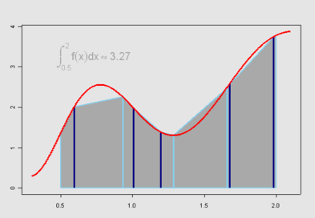
Numerical Differentiation and Integration (1)

Slide 2

Numerical Differentiation
Differentiation is inherently sensitive
small perturbations in data cause large change in results
Integration is inherently stable
e.g., two functions below have similar integrals but very different derivatives

Slide 3
Numerical Differentiation (cont.)
To approximate the derivative of a function whose values are known at discrete points, fit a smooth function to the given data and then differentiate the approximate function
If data are noisy, then smoothing the approximate function, e.g., least squares curve fitting, is more appropriate

Slide 4
Numerical Differentiation Methods
1. Finite difference approximation
based on the Taylor series expansion
2. Divided differences
approximate f’(x) by the derivative of a polynomial function that approximates f(x)
3. Method of undetermined coefficients
Similar to 2, but NOT computing the polynomial
Directly compute the weighting coefficients
Better for higher order derivatives

Slide 5
Derivatives
Definition from calculus
Forward-difference approximation
Backward-difference approximation

Slide 6
Finite Difference Approximations
Forward/Backward difference methods for computing numerical derivatives of a function are called finite difference approximation
The approximation error can be analyzed by considering the Taylor series expansions of a function

Slide 7
Error Analysis
Forward difference
Backward difference
first order accurate: O(h)

Slide 8
Central Difference Approximation
Error reduced if forward and backward difference approximation are combined
second order
accurate: O(h²)

Slide 9
Central Difference Approximation for Second-order derivative
second order
accurate: O(h²)

Slide 10
Example from “Scientific Computing”
http://www.cs.illinois.edu/~heath/iem/integration/fda/

Slide 11
Derivatives from Divided-Differences
Finite difference formulas can also be derived by the polynomial interpolation
Less cumbersome than Taylor series for higher-order accuracy or higher-order derivatives
Can be generalized to unequally spaced points more easily

Slide 12
Derivatives from Divided-Differences
Polynomial interpolation by divided-difference
where

Slide 13
Derivatives from Divided-Differences
Polynomial interpolation by divided-difference
If P_{n}(x) approximates the original function well, we should get a good match to the derivative by differentiating P_{n}(x)

Slide 14
Differentiate P_{n}(x)

Slide 15
Error of Approximated Derivative
We can compute the error by differentiating the error term in the polynomial interpolation
Recall that the error term for polynomial interpolation is

Slide 16
Error of Approx. Derivative (cont.)
Differentiate the error term

Slide 17
Error of Approx. Derivative (cont.)
When x=x_{i}, we can express error of f’(x) as

Slide 18
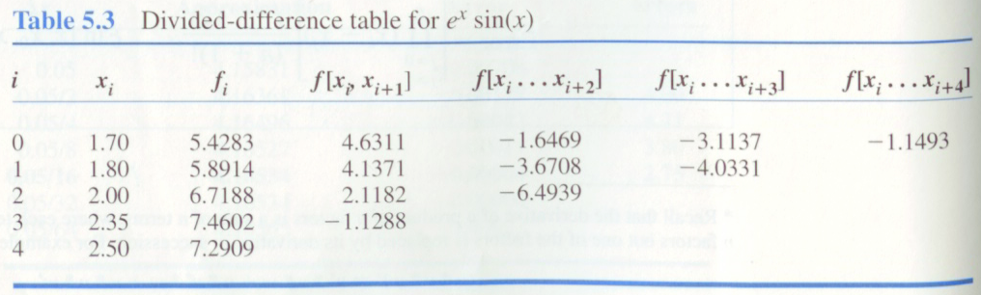
Example: f(x)=e^{x}sin(x)
Divided-difference table

Slide 19
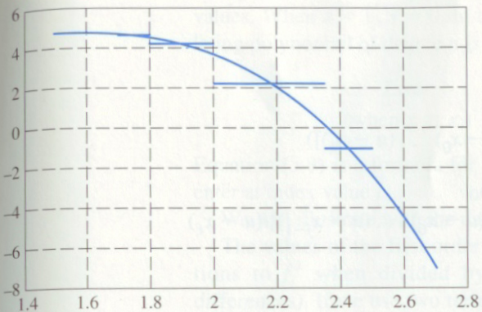
Example
First difference approximation

Slide 20
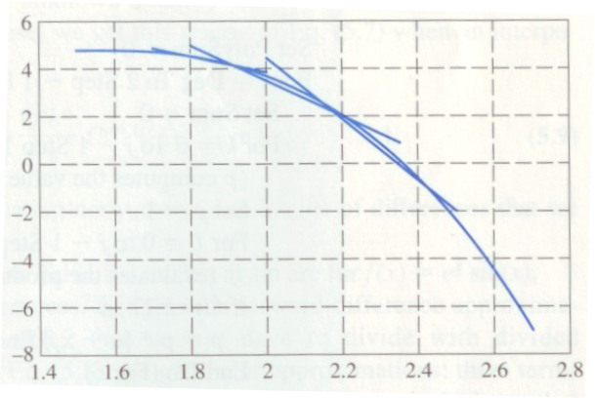
Example (cont.)
Second difference approximation

Slide 21
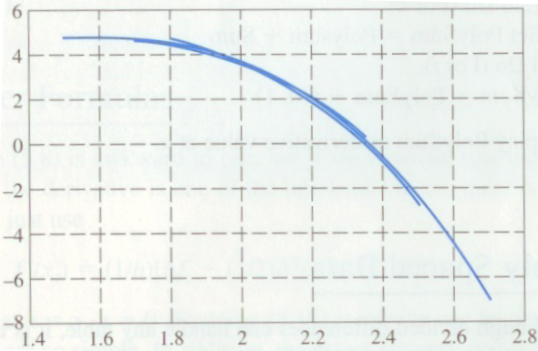
Example (cont.)
Third difference approximation

Slide 22
Higher-Order Derivatives
Methods of undetermined coefficients
Idea: represent derivative as a linear combination of function values at evenly spaced points
x₀-nh
…
x₀-h
x₀
x₀+h
…
x₀+nh
x_{-n}
…
x₋₁
x₀
x₁
…
x_{n}
f_{-n}
…
f₋₁
f₀
f₁
…
f_{n}

Slide 23
How to determine coefficients?
Fit 2n+1 points with a 2n-degree polynomial P(u) which satisfies
P(-nh) = f_{-n,} …, P(-h) = f₋₁ , P(0) = f₀, P(h) = f₁ …, P(nh) = f_{n}
P(u) is a general 2n’th degree polynomial→ any polynomial of lower degree than 2n is a special (degenerative) case of P(u)
P(u) = 1, P(u) = u, …., P(u) = u^{2n}
These special cases are used to construct 2n+1 equations by plugging f_{-n,} … f_{n} into

Slide 24
Example: Second-order Derivative
Suppose we want to approximate f”(x₀) using 5 points centered at x₀
We need a 4th degree P(u) to fit these points
Using methods of undetermined coefficients, we consider 5 special cases

Slide 25
Case 1 & 2: P(u) = 1, P(u) = u
P(u) = 1
f₋₂= f₋₁ = f₀ = f₁ = f₋₂ = P(u) = 1
f”(x₀)= C₋₂+C₋₁+C₀+C₁+C₂ = P”(0) = 0
P(u) = u
f₋₂ = P(-2h) = -2h, f₋₁ = P(-h) = -h, f₀ = P(0) = 0, f₁ = P(h) = h, f₂ = P(2h) = 2h
f”(x₀)= C₋₂ (-2h)+C₋₁(-h)+C₀(0)+C₁h+C₂(2h) = P”(0) = 0

Slide 26
Case 3 & 4: P(u) = u², P(u) = u³
P(u) = u²
f₋₂ = P(-2h) = 4h², f₋₁ = P(-h) = h², f₀ = P(0) = 0, f₁ = P(h) = h², f₂ = P(2h) = 4h²
f”(x₀)= C₋₂ (4h²)+C₋₁(h²)+C₀(0)+C₁h² +C₂(4h²) = P”(0) = 2
P(u) = u³
f₋₂ = P(-2h) = -8h³, f₋₁ = P(-h) = -h³, f₀ = P(0) = 0, f₁ = P(h) = h³, f₂ = P(2h) = 8h³
f”(x₀)= C₋₂ (-8h³)+C₋₁(-h³)+C₀(0)+C₁h³ +C₂(8h³) = P”(0) = 0

Slide 27
Case 5: P(u) = u⁴
P(u) = u⁴
f₋₂ = P(-2h) = 16h⁴, f₋₁ = P(-h) = h⁴, f₀ = P(0) = 0, f₁ = P(h) = h⁴, f₂ = P(2h) = 16h⁴
f”(x₀)= C₋₂ (16h⁴)+C₋₁(h⁴)+C₀(0)+C₁h⁴ +C₂(16h⁴) = P”(0) = 0
Collecting equations in case 1 to 5

Slide 28
Solving for coefficients C₋₂ , C₋₁ , C₀ , C₁, C₂

Slide 29
Example: 4th-order derivative
If 5 points are used

Slide 30
Richardson Extrapolation
In many problems, such as numerical differentiation or integration, approximate value for some quantity is computed based on some step size
Ideally, we would like to obtain the limiting value as the step size approaches to zero, but we cannot take the step size arbitrarily small because of excessive cost or rounding error
Based on approximate derivatives at nonzero step sizes, however, we may be able to estimate what approximate value would be for step size of zero

Slide 31
Richardson Extrapolation (cont.)
Basic idea: improve the order of accuracy by extrapolating from existing estimates
Example:
Suppose f’ is the true value and the approximation is 2nd-order accurate
h | Approximation
0.05 | 4.15831
0.025 | 4.16361

Slide 32
Richardson Extrapolation (cont.)
Increase accuracy by eliminating low order error terms
Let g(h) and g(h/2) be two approximations for a derivative whose true value is f’
If both approximations are 2nd-order accurate
3rd-order accurate can be achieved by
1
2
2
- (1/4) ×
1

Slide 33
Richardson Extrapolation (cont.)
1
2
3rd-order accurate can be achieved by
2
- (1/4) ×
1

Slide 34
Richardson Extrapolation (cont.)
Generalize to nth-order accurate approximation
1
2
2
- 2^{-n} ×
1

Slide 35
Richardson Extrapolation (cont.)
O(h^{r}): rth-order accurate

Slide 36
Richardson Extrapolation (cont.)
Extrapolated value, though improved, is still only an approximation, not exact solution, and its accuracy is still limited by step size and arithmetic precision used
If g(h) is known for several values of h, then extrapolation process can be repeated to produce still more accurate approximation, up to limitation imposed by finite-precision arithmetic

